Slide 1
Data mining Used cars
By Manuel Esteban Arias

Slide 2
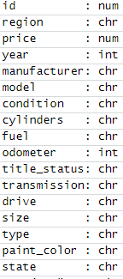
Introduction
n_orginal= 426 800 cars
n_Final=421 344
Where= US
Variables: 26
Retained_variables: 16
Retained_data: 98,48%
Imputation: “unknown” in categorical NaN
Dropped Qualitatives: multiples of 10 , or mono digits)
Dropped Qualitative: Text variables and context variables
Database of Used Cars in US scrapped from a announce car selling websites.
This database includes contextual variables (place, website, posting date..) and car variables (color, cylindrage, model, condition…)

Slide 3
Exploratory Analysis

Slide 4
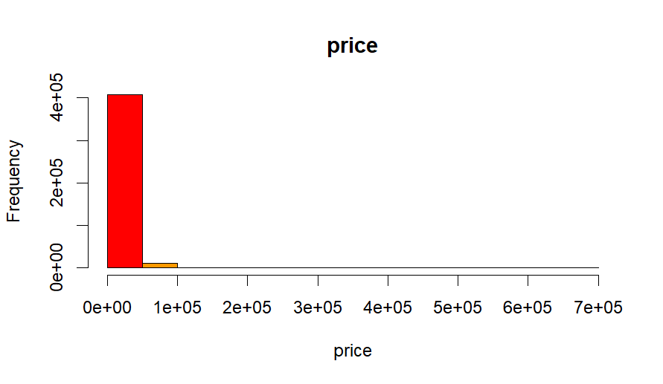
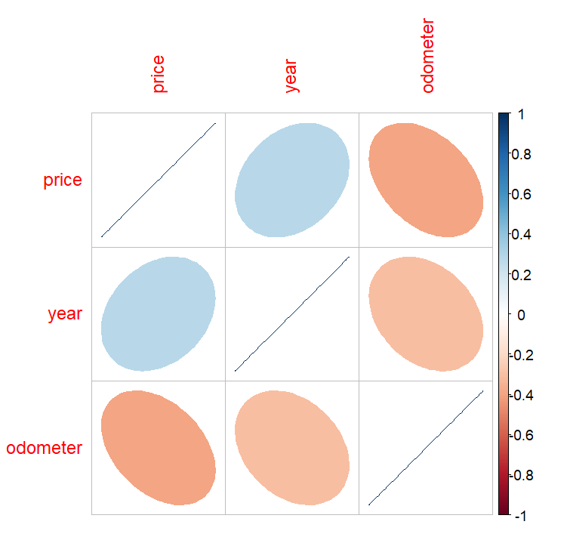
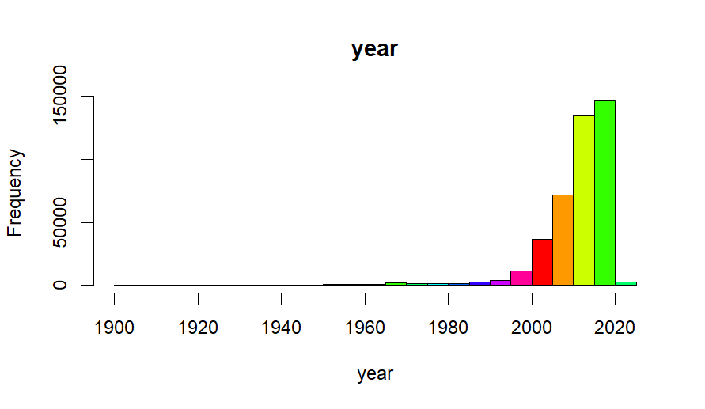
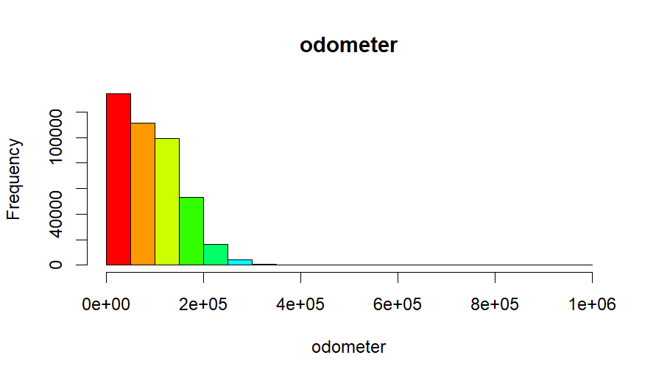
Quantitative Variables
The price and the odometer are very concentrated in the beginning of the distribution (most of cars have not more than 200 000 mle and the price does not pass the USD 50 000 )
Mos of the care have not more than 30 years
The prices and the year are positively correlated (0,2753).
The odometer is negatively correlated with the prie and the year (-0,3904 and -0,3028 respectively). Owners of old cars are not reporting the information as they should.

Slide 5
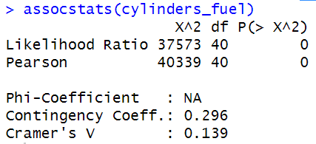
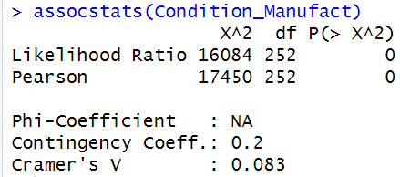
Qualitative Variables
The Quality of the car’s manufacturer has not a significant impact in the condition in which the care is kept.
The higher clydinrage may bised the fuel election but not as much as we were expecting

Slide 6
Unsupervised analysis

Slide 7
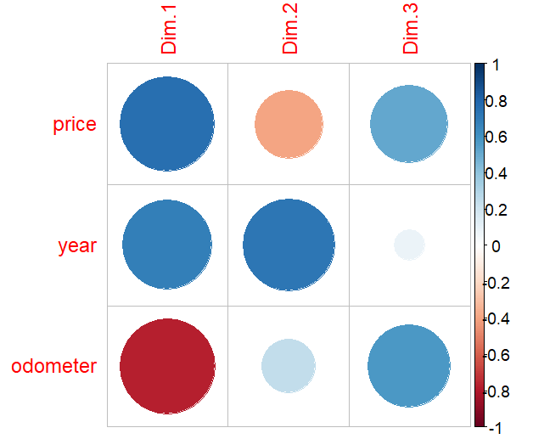
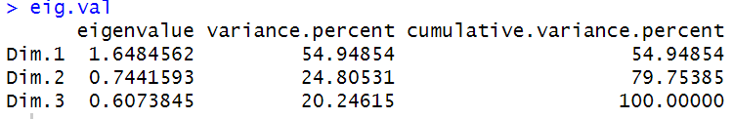
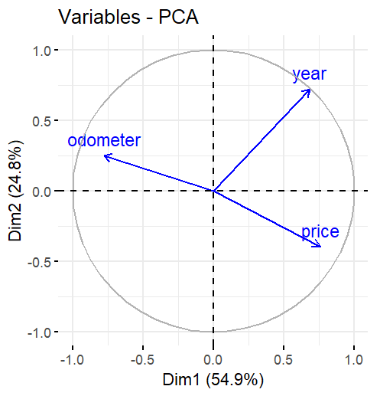
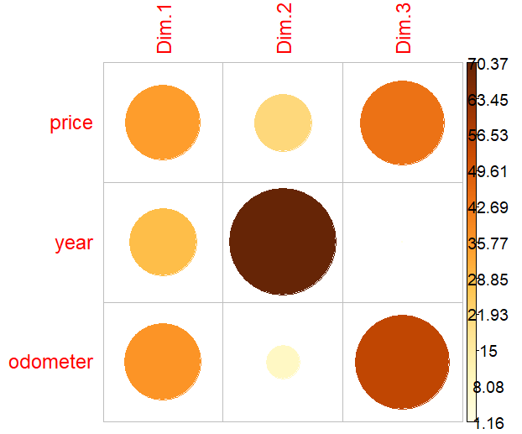
PCA for Quantitative variables
Correlation:
Contribution:
3 dimensions, explaining all the variance of the data
While price and odometer are inversely correlated, the year seems not to be (perpendicular).
Year have their own dimension (dim 2)

Slide 8
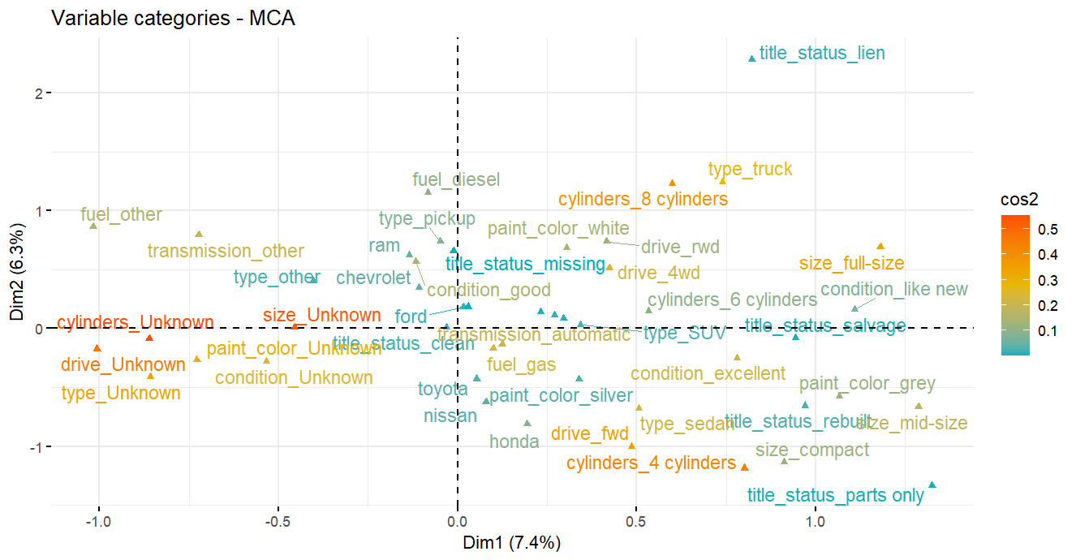
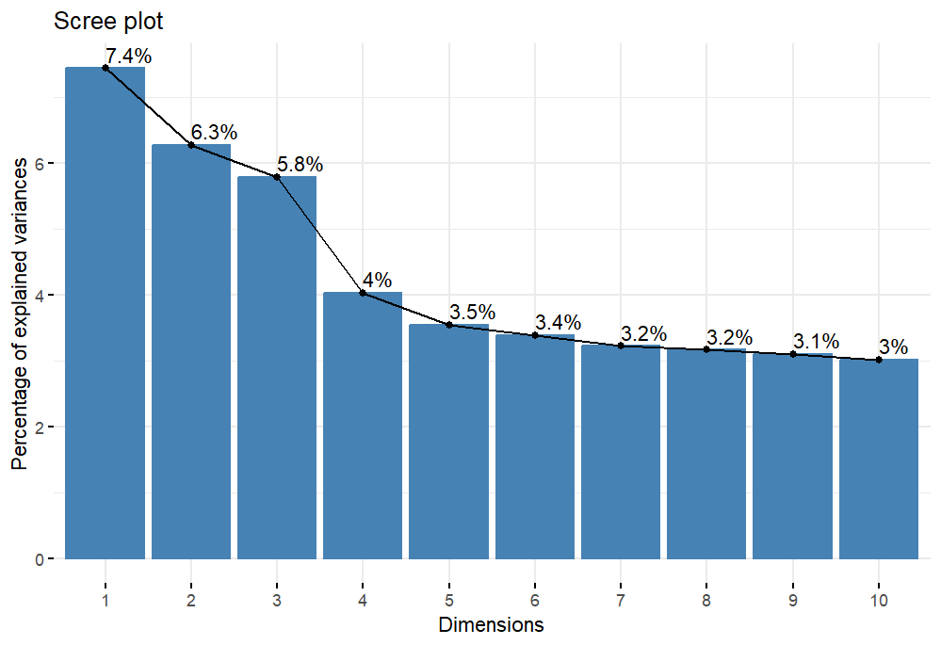
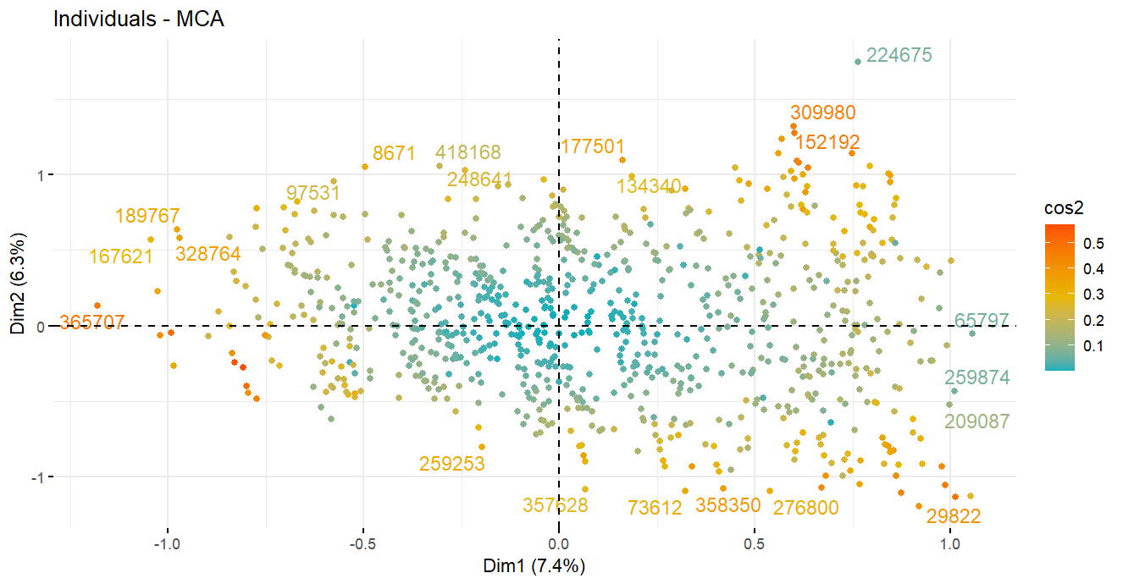
MCA for qualitative variables
Originally, dim 1 explains 0,4% of variance.
Region and State dropped
New dimensions are not very representative either.
Unknown cars apilate at the left.
Big cars are allocated in the upper quadrants.
Brands and titte_status not very associated
Dim 1= Unknowns
Dim 2= Trucks
Dime3= Others

Slide 9
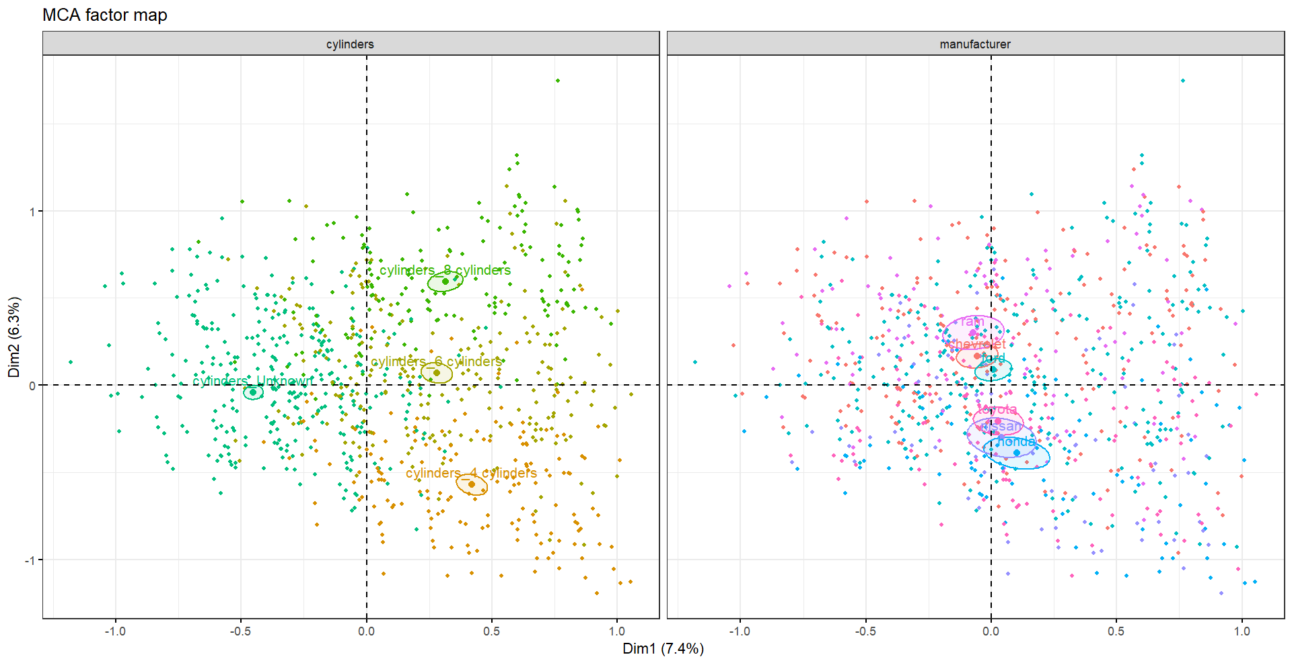
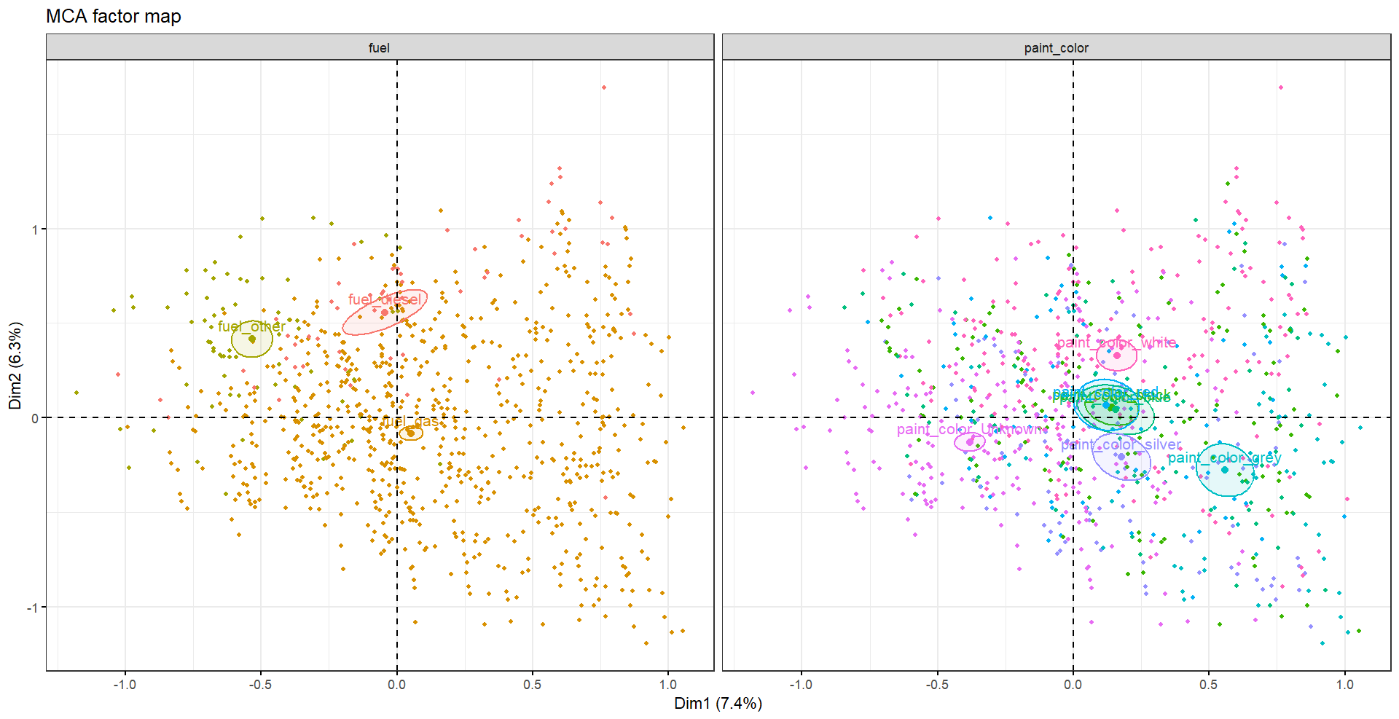
Bigger cars are allocated in the upper quadrants.
Most of the cars use gas, bigger cars use diesel, other fuels are used by unknown cars.
American cars are bigger, Japanese cars are smaller.
Gray color are more frequent among small cars, White for big cars.

Slide 10
Supervised analysis : An OLS regression approach

Slide 11
Why OLS Regression
Simple and easy to understand, better than decision trees
Hypothesis testing,
The relationship between variables is mostly linear,

Slide 12
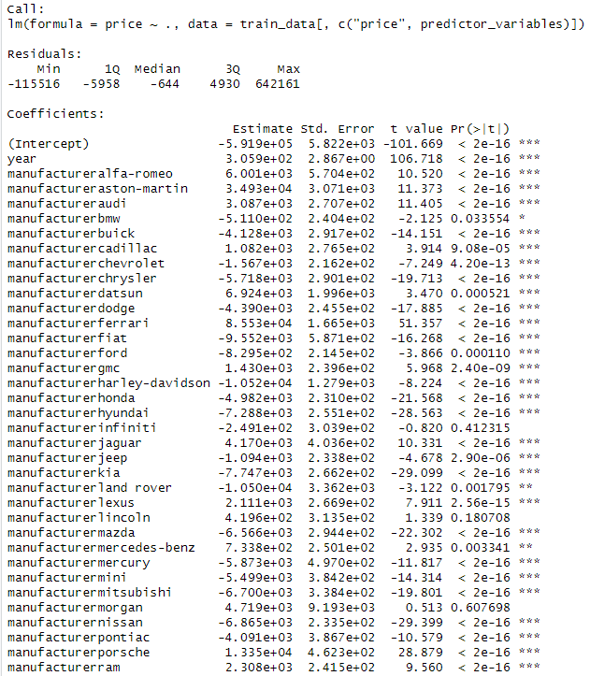
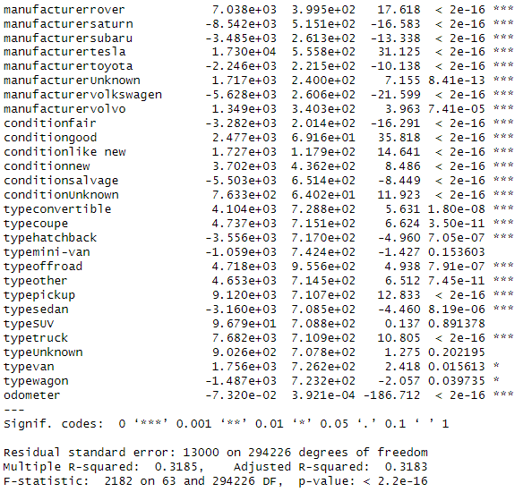

Slide 13
Output of the Model
Model is not very powerful: 0.31 R-squared
Variables are mostly significative.
Year is positively correlated with Price
Alfa-romeo, Jaguar, Ferrari, Lexus and Porsche push price up from the average price.
Conditions good, like new, new push the price up as well.
Coupe type, convertible,offroad, pickup, SUV and truck have a positive effect on the price.

Slide 14
Most interesting features
Manufacturer (some manufacturers over the others)
Model,
Year,
Odometer,
Fuel,
Type (some types over the others),
Condition,

Slide 15
Conclusions
Mainly two classes of cars can be seen: small (sedan, compact…) and big(truck, SUV…) cars.
The brands divided the market among big and small cars.
Elite brands push up the prices from average.
The big and small cars determine often the cilyndrage
New cars are effectively more expensive
Conditions good, like new, new push the price up as well ( Fair, andSalvage down).
Coupe type, convertible,offroad, pickup, SUV and truck have a positive effect on the price.
The sedan, hatchback have negative effect on the price.
While year and odometer are correlated, the time is not dependent on them.
Elite car owner don’t necessarily take more care of their cars.
People is not as careful as the should when filling online announces.

